Slide 1



Did quaking aspen (Populus tremuloides) recover following the 2010 Schultz Fire, AZ?
Sam Ebright
Mentor: Pete Fulé
Presented to: 2018 NASA Space Grant Symposium

Slide 2
Background
Schultz fire, 2010
Catastrophic high severity wildfire, burned over 13,000 acres
High mortality, massive flooding events
Populus tremuloides
Fire resilient species
Adapted to sprout from roots after fire
Sudden Aspen Decline (SAD)
Remote sensing
Obtaining information from satellite or aerial data

Slide 3
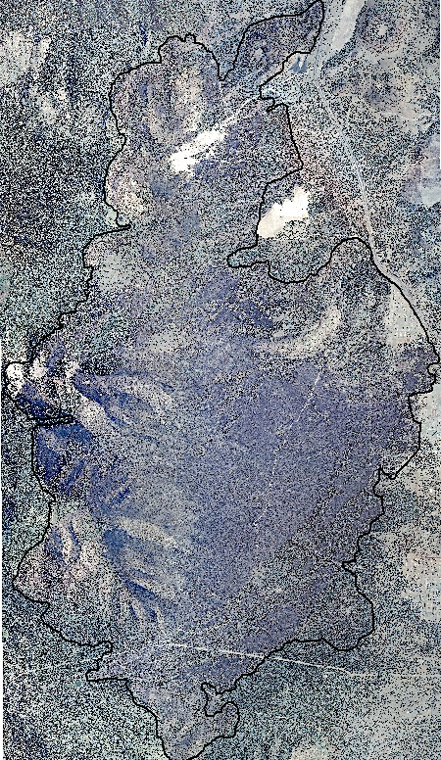
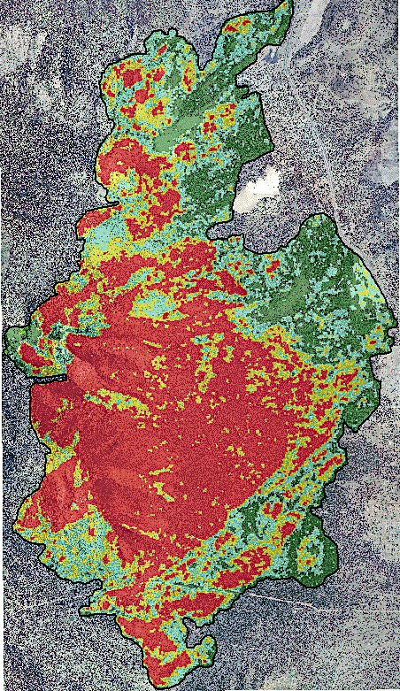
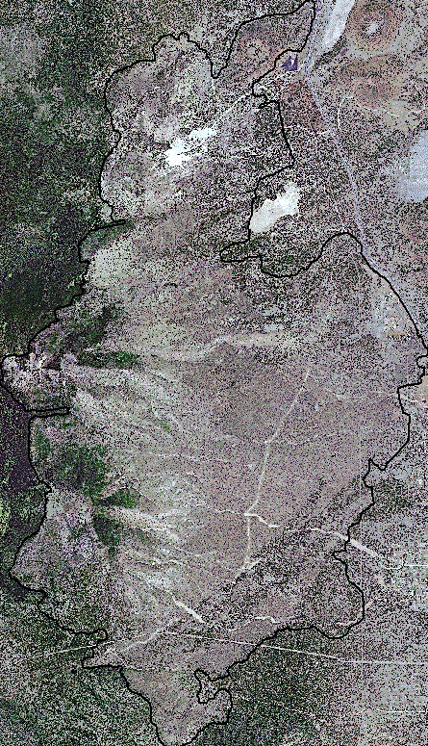
2010 Schultz Fire

Slide 4
Project Goals
To remotely sense post-fire aspen regeneration, within the Schultz burn scar
To analyze differential effects of burn severity on aspen regeneration
To gather data relevant to ongoing change in climate and fire regime
To create a tool for remote sensing of aspen

Slide 5
Hypotheses
That aspen will resprout after the Schultz fire, but cover a much smaller area than before
That aspen will show higher regeneration densities in low-moderate than in high severity burned areas

Slide 6
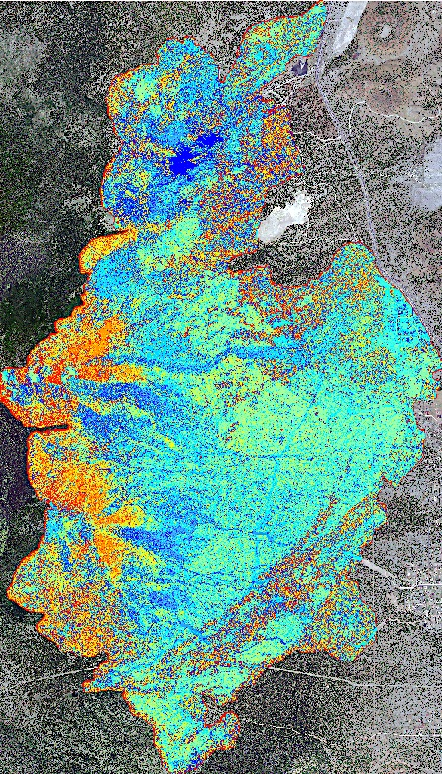
Lab Methods
Remote Sensing:
Normalized Vegetation Index (NDVI)
4-band imagery RGB+Near-Infrared
Unsupervised Classification
ISO Cluster
Texture analysis
7x7 pixel crown radius

Slide 7
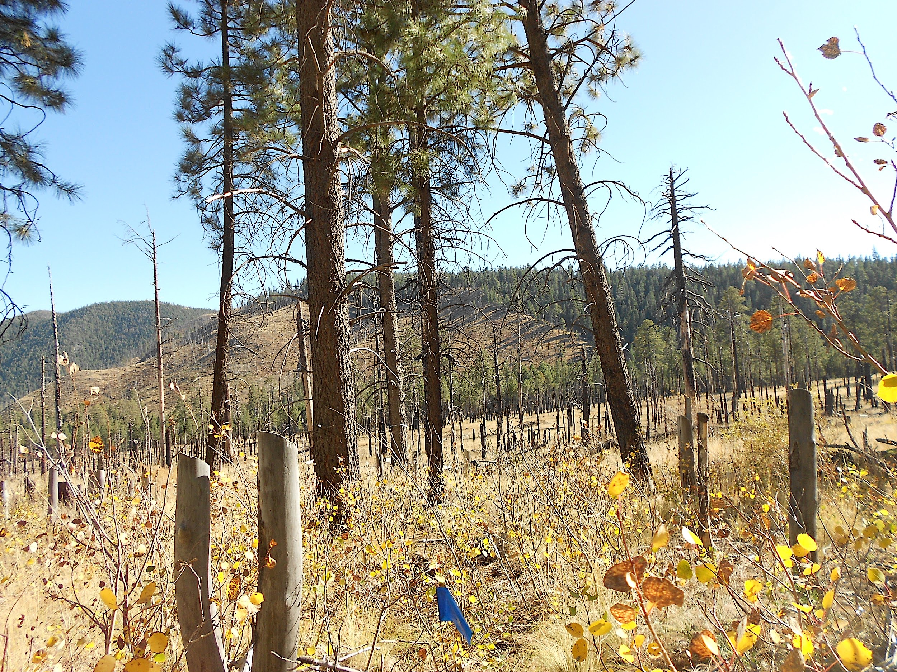
Field Methods
Field Verification
50 points
Browsing and Damage
Density:
n-Tree method
10 plots

Slide 8
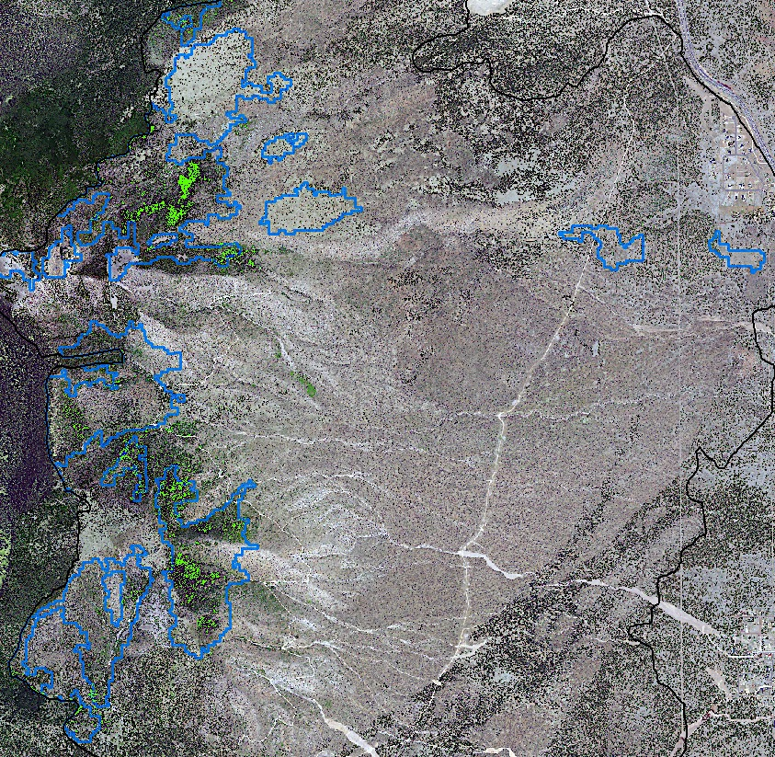
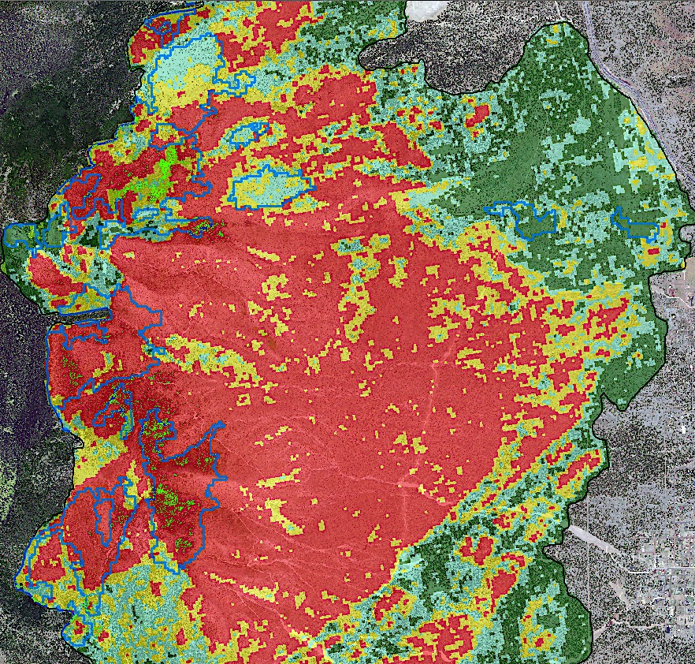

Slide 9
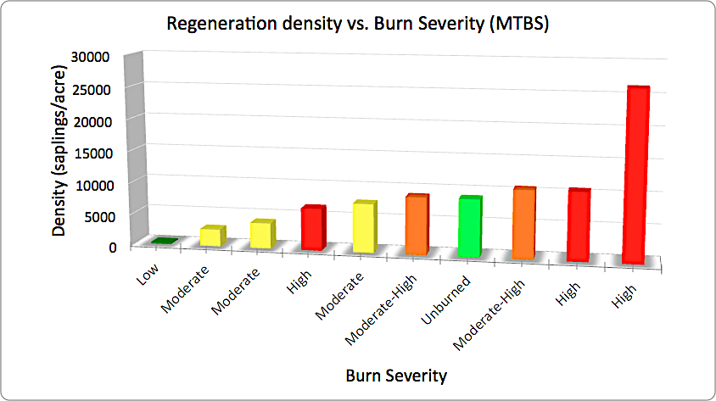
Density
Regeneration density shows positive correlation with burn severity
Contrary to our hypothesis
But, correlation does not imply causation...

Slide 10
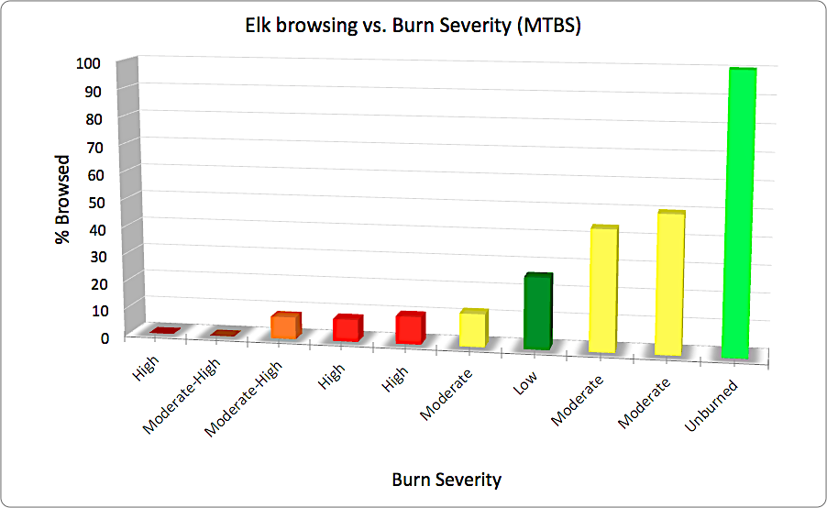
Elk browsing
Mild browsing impact in high severity
High browsing impact in unburned to moderate severity
Ease of access for ungulates

Slide 11
Conclusions
Aspen IS regenerating following the Schultz fire
Regeneration is denser in high severity burned areas than low-moderate
Remotely sensed aspen regeneration covers roughly 130 acres; as compared to near 2,000 acres reported in 2004
Overbrowsing by ungulates heavily affects aspen suckers
Ongoing investigation to remotely sense 2010 pre-fire aspen

Slide 12
Acknowledgements
Thank you sincerely to all those who have supported me in this project:
NAU Forest Ecology Lab
Pete Fule, Faculty Mentor
Alicia Azpeleta, Lionel Whitehair, Jaime Yazzie, and Tyler Mockta, Graduate Students
NASA Space Grant Internship
Funding and guidance
Kathleen Stigmon and Nadine Barlow
Northern Arizona University

Slide 13
Thank you!
Any questions?

